Slide 1
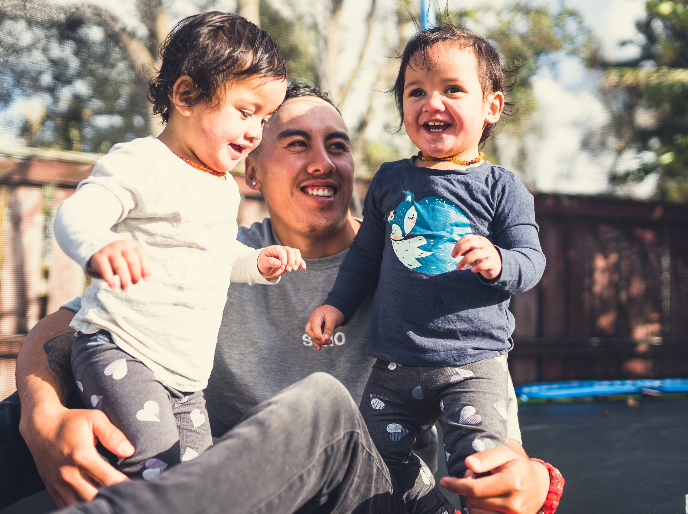
Representation Review Community Meeting
2 August 2021
Notes:
Dr James Graham [welcome and opening karakia]
Craig Cameron
A warm welcome to Council’s Pre-engagement Community Meeting. Before we get into this evenings conversation, I will introduce the team we have sitting here in the hot seats.
My name is Craig Cameron... Etc.
Joining us this evening is Darryl Griffin from Elections NZ, and Ross McLeod, who will be a familiar face to many as a previous CE of HDC, who is assisting with this project.
So in terms of this evening, this meeting is a chance to have a conversation about the factors that reflect how you are represented at the council table. Tonight we will go through a basic overview of how that representation is determined, and provide you with opportunities to ask questions about the process and options as we go. The meeting is being livestreamed via Facebook, so those watching can also post questions in the comments area which our team will pass on for us to respond to at the relevant time. I will just mention that because the meeting is livestreamed, we will need to ensure questions are captured in a microphone, so to ask a question, you may either come to the podium microphone, or you can ask a question from your seat and we will repeat it back before answering.
I’m going to hand over to Ross and Darryl now, who will take us through an overview of the journey thus far, and the factors that make up council represenation.
Darryl
•Related steps:
•Choice of electoral system (FPP/STV) ss. 27 to 34
•Option of dedicated Māori representation ss. 19Z to 19ZH and Local Electoral ( Wards and Constituencies) Amendment Act 2021
•These decisions by councils not appealable to LGC
•Initial steps have implications for representation arrangements – consider as a package

Slide 2
What is a Representation Review?
Council needs to ensure its representation structure provides fair and effective representation for individuals and communities.
The review is a formal and quite complex process about how residents are represented on the Council
It applies to Council and Community Boards
Outcomes take effect for next elections in 2022 and for 2025
Formal community consultation
Must happen at least every 6 years (last reviewed in 2018) but the decision to introduce Māori Wards has triggered the requirements to commence another review this year
Notes:
A representation review is a formal process, required under the Local Electoral Act 2001, where Council looks at and proposes to the public, the basis on which it will be elected at the next elections and how many members there should be (excluding the Mayor). The public have a right to make submissions to Council’s initial proposal and also appeal or object to Council’s final proposal.
Council can undertake a review at any stage but it must take place every 6 years. The Council ‘s last review took place in 2019.
No resolution on Council’s initial representation proposal may be made before 1 March 2021 (already passed)
•Requirements of Local Government Act 2002 particularly s.14 principles for council to:
•Make itself aware of, and have regard to, the views of all its communities
•Take account of the diversity of the community’s interests
•Provide opportunities for Māori to contribute to decision-making processes
•Possible forms include:
•Surveys, referenda, discussion documents, newspaper advertising, focus groups, public workshops and meetings

Slide 3
Representation Arrangements
The key factors are - Communities of interest; Effective representation; and Fair representation
Decisions to be made:
How many councillors should be on Council. Currently we have 14, plus the Mayor, but could have as few as 6, and as many as 30.
How councillors should be elected - Should we elect the councillors by a ward system, or have a mix of some elected by wards and some elected at-large?
Do we retain the Rural Community Board? If so, how many members should there be and should they be elected by sub-divisions as at present or at-large?
Should we have more Community Boards?
Notes:
Key factors that must be carefully considered as part of the review and included in the options are:
Communities of interest;
Effective representation; and
Fair representation.
The review must consider the following issues in relation to the representation arrangements for the City:
whether Councillors are to be elected by electors of the District as a whole (at Large), by electors of a defined community of interest (Wards) , or by electors with a mix electors of the District at large and by electors of wards;
the proposed number of Councillors to be elected in each category - at large/ward/mixture;
If there are to be Wards - the proposed boundaries and name for each ward;
whether there should be community boards, and if so the nature of a community and structure of a community board.
Each option must provide clear and logical rationale
•Don’t pay lip service to review, give it a ‘good crack’
•Consider preliminary consultation with the community
•Consider whether an independent panel or external involvement in a review panel can add value
•Remember that consideration of community boards must form part of the review
•A comprehensive exercise may not be required every time, but every so often there will be benefit in a fundamental review

Slide 4
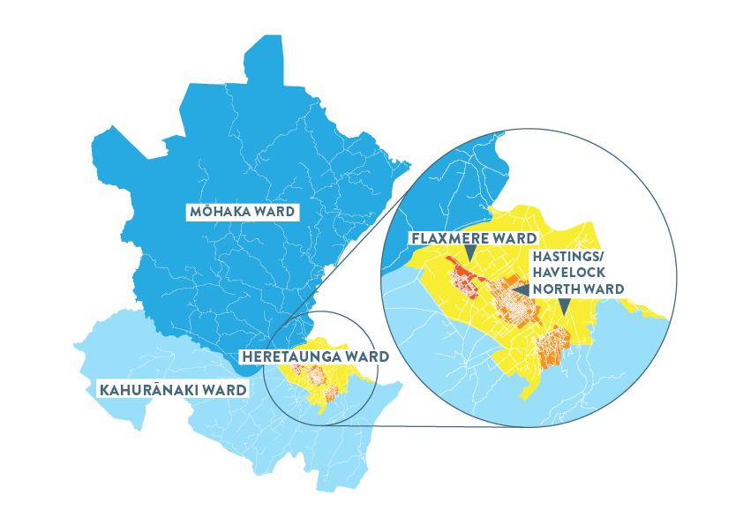
Current Representation
1 mayor elected “at large” (across the whole district)
14 councillors elected by electors of their ward only
Flaxmere 2 councillors
Mōhaka
1 councillor
Hastings/ Havelock Nth 8 councillors
Kahurānaki
1 councillor
Heretaunga
2 councillors
Notes:
The current wards reflect Hastings district’s communities of interest identified in the 2018 representation review.
Each councillor currently represents an average of 6,284 voters, with a variance of no more than + or - 10%. We’ll come to the ‘10% rule’ a little later on.

Slide 5
What is Council Considering?
Distinct communities of interest in Hastings District and prefer to retain a ward system
Current ward structure largely reflects and provides for effective representation
14 councillors provide for good governance and share the workload
Electing some councillors at large not considered to help effective representation
Māori view (Heretaunga Takoto Noa Māori Standing Committee) on one or more Māori Ward/s required
Rural view (Rural Community Board) on rural representation required.

Slide 6
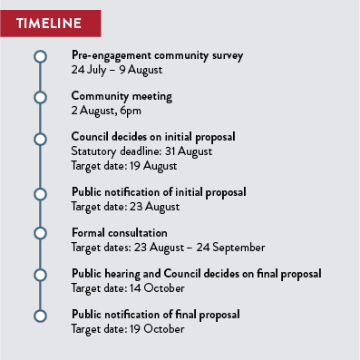
The Timeline
Formal consultation will take place once Council notify a proposal in August.
Notes:
6 July Council Workshop
End of July–Council decide how the review will be done and from then on the various options will be developed
12 August Council meeting – make decision on the proposal to go out for formal public consultation. Public notice must be done within 14 days of the Council decision being made
September/October Hear submissions within 6 weeks of closing time and give public notice of the final Council decision.
14 October Council meeting – Final proposal
19 November Closing of objections and appeals to the final proposal
by 15 January 2022 Forward all relevant information to the Local Government Commission if any are received. If no
objections or appeals are received the decision becomes final.
Prior to 10 April 2022 Local Government Commission Determination if objections have been received.

Slide 7
Communities of Interest
What communities of interest do you think make up the Hastings district?
Factors that may define a community of interest include:
Geographical features
Economic activities
Shared facilities and services (e.g. schools, libraries)
Distinctive history
Transport routes
Community activities and focal points
The rohe or takiwā of local mana whenua

Slide 8
Māori Representation
Council has decided to introduce Māori Ward/s into its representation arrangements. Council needs to determine whether to have one or more than one Māori Ward/s. Council is keen to hear the views of those on the Māori electoral roll and tangata whenua.
The number of Māori ward councillors on Council is determined by a formula in the Local Electoral Act 2001 based on the total number of councillors elected from wards.
For Hastings District:
With a total of 8 or less councillors in total elected from wards there must be 1 Māori ward councillor
With a total of 9 to 13 councillors in total elected from wards there must be 2 Māori ward councillors
With a total of 14 to 18 councillors in total elected from wards there must be 3 Māori ward councillors
Notes:
In the 2022 and 2025 elections voters on the Māori electoral roll will vote for candidates standing in the Māori ward or wards. Voters on the General electoral roll will vote for those standing in General wards. All electors may vote for the mayor and any Council positions being elected at large.

Slide 9
Electing Councillors
How do you think councillors should be elected?
Councillors may be elected by either:
a ward system, or
a combination of at large and wards
The mayor is elected at large and councillors are currently elected by ward.
Notes:
*as Council has decided to have a Māori ward or wards, it cannot elect all councillors at large - it must have at least one General electoral ward.
A mixed system, where some councillors are elected from wards and some at-large, can be seen to provide a balance between representation of district-wide interests and ward concerns.

Slide 10
Mix of elections: - ‘at large’ and wards
Considerations:
Is this considered good governance for the district?
Are the number of councillors right?
Councillors elected at-large are not included in the calculation to determine the number of Māori ward/s
With Māori ward/s there must be at least 1 General ward
Does having some elections at-large and some by way of wards meet the fair and effective representation requirements?
All General wards and all Māori wards separately must comply with the “+ or – 10%” rule
Mayor and some Councillors are elected by the electors of the whole district whilst others are elected by wards

Slide 11
Number of Councillors
How many councillors do you think Council should have?
What is the minimum and maximum number of Councillors?
Under law, Council can have between five and 29 councillors plus the mayor.
In 2019, 14 was considered the right number of councillors to provide good governance, share the workload and provide effective representation.
What about the cost of remuneration?
The total remuneration cost is not affected by the number of members the Council decides to have.
Notes:
The community may have views on whether a smaller or larger number might produce better governance and representation.
Under the current arrangements, the Remuneration Authority sets the total remuneration pool that is paid to the mayor and councillors. This would likely be divided among the councillors elected.

Slide 12
Ward Boundaries
If wards are retained, what changes (if any) do you think are needed to reflect communities of interest?
If wards are retained, the number of wards, their boundaries and their names need to be determined.
In 2019 the current wards were deemed to best reflect communities of interest, but communities of interest may change over time.

Slide 13
Impact of Changes
General and Māori Electoral Populations (2020 Estimates):
WARD | Population | Current No. of Councillors | Current Population per Councillor | General Electoral Population | Māori Electoral Population
Hastings – Havelock North | 50,110 | 8 | 6,264 | 42,800 | 7,310
Flaxmere | 12,250 | 2 | 6,125 | 6,880 | 5,370
Heretaunga | 12,410 | 2 | 6,205 | 10,500 | 1,910
Mōhaka | 6,570 | 1 | 6,570 | 5,940 | 630
Kahurānaki | 6,640 | 1 | 6,640 | 5,490 | 1,150
TOTAL | 87,980 | 14 | Avg 6,284 | 71,610 | 16,370

Slide 14
Current Ward Boundaries & Distributions
WARD | Population | No. of Councillors | Population per Councillor | Deviation from District Average Population per Councillor | % Deviation from District Average Population per Councillor
Hastings-Havelock North | 50,110 | 8 | 6,264 | -20 | -0.37%
Flaxmere | 12,250 | 2 | 6,125 | -159 | -2.56%
Heretaunga | 12,410 | 2 | 6,205 | -79 | -0.97%
Mōhaka | 6,570 | 1 | 6,570 | 286 | 4.52%
Kahurānaki | 6,640 | 1 | 6,640 | 356 | 5.63%
TOTAL | 87,980 | 14 | AVG = 6,284

Slide 15
The ‘+/- 10% Rule’
The +/-10% rule is an important guide in assessing fair representation.
This rule means the ratio of councillors to the electoral population in each ward should produce a variance of no more than 10%.
Any departure from the +/-10% rule must be specifically approved by the Local Government Commission.

Slide 16
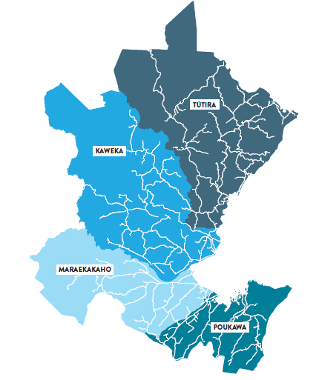
Rural Community Board
Current representation:
Tūtira
1 member
Kaweka
1 member
Council has ONE community board for the RURAL area
Hastings district’s Rural Community Board is divided up into FOUR electoral subdivisions covering the Mōhaka and Kahurānaki wards.
Council appoints the two councillors representing the Kahurānaki and Mōhaka wards to the Rural Community Board.
Maraekākaho
1 member
Poukawa
1 member

Slide 17
Rural Community Board
Considerations:
Is the Rural Community Board still relevant and contributing to the good governance of the District?
Are the boundaries still appropriate?
Are the numbers of members right? Should there be Council-appointed members (currently 2, could also appoint a Māori Ward councillor)? If so, how many?
Should the community board have electoral subdivisions? Currently there are 4 – Tūtira, Kaweka, Maraekākaho and Poukawa.
The same criteria for fair and effective representation applies to community boards just as it does to the Council – all 4 electoral subdivisions comply with the +/- 10% margin.
Notes:
Community boards can have between four and 12 members. At least four must be elected members. The number of members appointed by Council must be less than half the total number of members.

Slide 18
Community Board
Are more community boards needed for the good governance of the district?
If it is decided Hastings district should have more community boards, we need to determine:
the number of boards
their boundaries and
the number of members
Notes:
Community boards can have between four and 12 members. At least four must be elected members. The number of members appointed by Council must be less than half the total number of members.

Slide 19
Process from Here
Advertise and advise of appeal provisions
Send all information and appeals/objections to LGC
LGC Determination April 2022
Notes:
Refresher on timeline, but detail on the steps following notification of final proposal as per red box.

Slide 20
Submissions, Appeals & Objections
Anyone can make a written submission on Initial Proposal
Council considers submissions and makes decision on Final Proposal
Public may lodge written appeal/objection to LGC on Council’s Final Proposal
Where appealed Local Government Commission determines outcome
Wards that are outside the +/- 10% margin must be referred to the Commission for determination
This process cannot re-litigate Māori representation, but people can submit on number and boundaries of Māori wards, and the names of Māori wards.
Notes:
Any person or organisation may make a written submission to Council’s proposal. Council then considers all submissions and may decide to amend its original proposal. If an original submitter is still not satisfied with Council’s decision, they may make a written appeal. Any person or organisation may lodge a written objection to a proposal that has been amended.
The issue of whether or not to have Māori Wards cannot be relitigated. Any other issues relating to representation including the number of members (where that is discretionary), number and boundaries (communities of interest) of Māori Wards, names of Wards etc

Slide 21
We welcome your views
We need your feedback by Monday 9 August
Head to www.myvoicemychoice.co.nz to complete the survey, OR
Fill out the form and drop it in the submission boxes at either our Customer Service Centre on 207 Lyndon Road East, or the Hastings, Flaxmere or Havelock North libraries
Find out more at www.hastingsdc.govt.nz/representation
Public notification of initial proposal: 23 August
Formal consultation: 23 August – 24 September

Slide 22
Thank You

